Slide 1
End of Workshop Presentation: Data Analysis of Previous Siganus fuscescens Data (2018)
Zoe Ruben
Texas A&M University – Corpus Christi
Mentor: Dr. Chris Bird

Slide 2
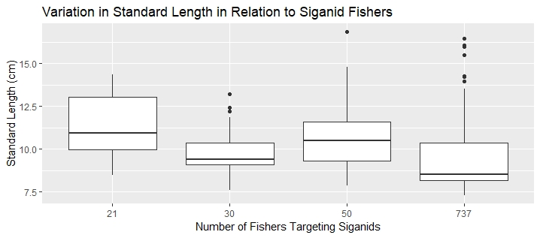
Stat | Value
T | 14.27
Df | 168.01
P-value | <2.2e-16
H1: There will be significant difference in standard length of S.fuscescens depending on number of fishers targeting S.fuscescens.

Slide 3
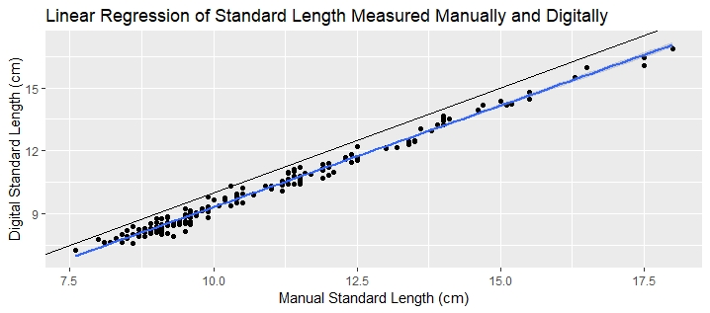
H2: Manually determined standard length is proportionate to digitally determined standard length.
In y=mx+b format: y=1.021087x + 0.486731 (using linear model summary)

Slide 4
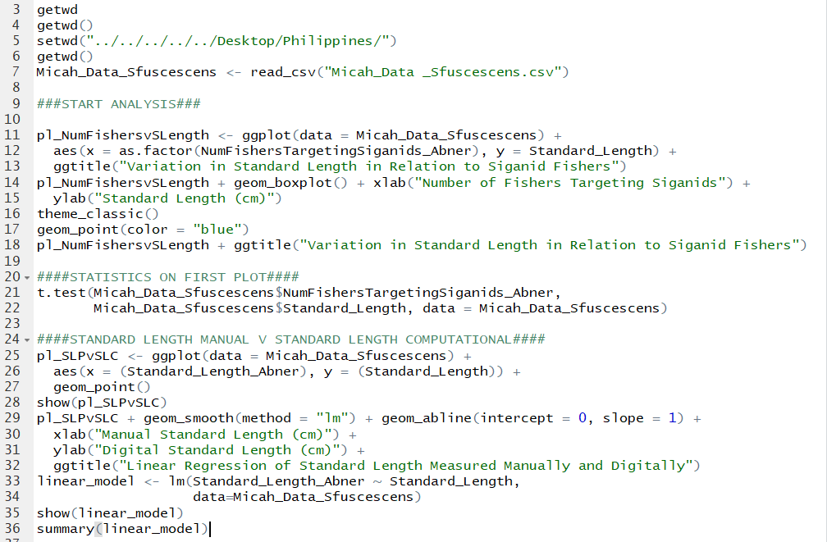
Code Editor

Slide 5
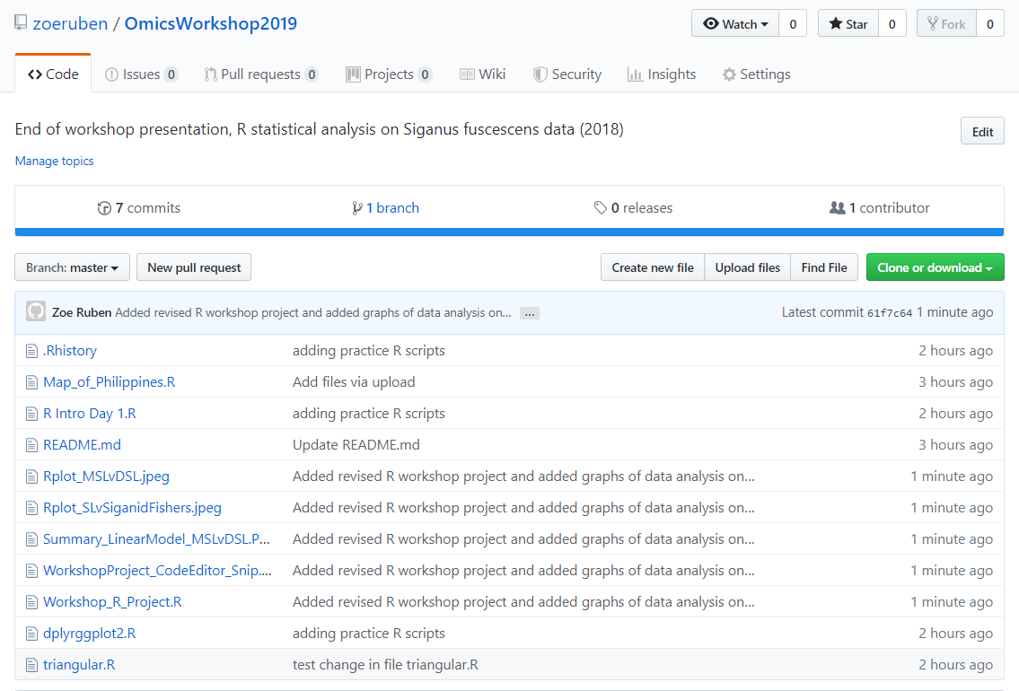
GitHub Account with R Script

Slide 6
Thank You ☺

